Slide 1

VAST CHALLENGE 2018 MC3
Team Members:
Supriya Bommisetty
Renuka Jatoth
Chandra Prem Putheti
Nagasindhura Vadla
Siva Dharma Sastha Madala

Slide 2
Team Contribution
Team Member | Contribution
Supriya Bommisetty | Using Python, combined all the files and created a single dataset with the required columns. Done analysis on transformed data for each datasets using Tableau. Developed worksheets on company growth ,purchase growth and suspicious data in Tableau. Slides(8,11)
Chandra Prem Putheti | Analyzed the Dataset using Tableau Created Worksheets on Month wise communication trend of both kinds of data,Over all communication made by each suspicious employee. Used Excel to get more understanding of the data given. Slides(9,12)
Renuka Jatoth | Created Worksheets on communication analysis among the days of the week and suspicious communication trends.. Analyzed the Dataset using Tableau. Using Tableau, combined all the datasets and created a single view of the communication. Slides(10,14)
NagaSindhura Vadla | Created Python script to find the timestamp from the number of seconds given in the dataset. Analyzed the Dataset using Tableau. Created Worksheets on Year wise communication Trend, suspicious communication trend in each quarter. Slides(13,15)
Siva Dharma Sastha Madala | Analyzed the Dataset using Tableau Analysis on employee growth and purchase growth. Created Worksheets on suspicious communication trend followed by each source and destination. Created PPT by adding all the team-work Slides(16,17).

Slide 3
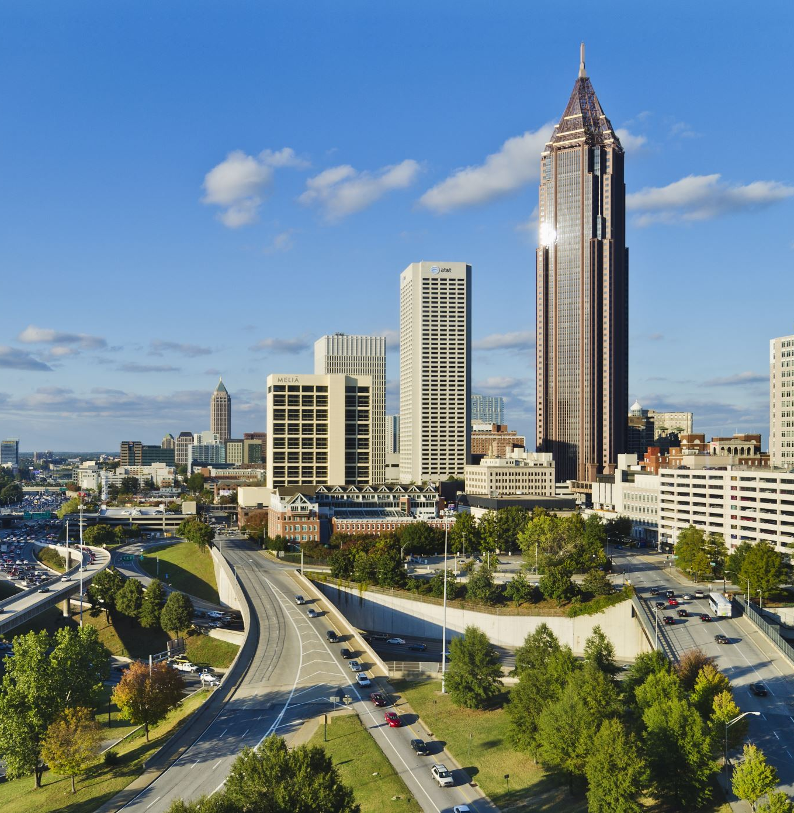
Overview
Mistford is a mid-size city located to the southwest of the Boonsong Lekagul Wildlife Preserve. The city has a small industrial area with four light-manufacturing endeavors. This city is struggling with the possible endangerment of the Rose-Crested Blue Pipit, a locally loved bird. An investigation has been prompted last year on the Kasios Office Furniture,because it represents itself as Eco-friendly Organization. Now we need to apply our visual analytics to investigate and to decide whether Kasios is responsible for that bird endangerment.

Slide 4

Big Graph Challenge
Mistford is getting affected by Kasios Furniture company. Grad student Mitch Vogel has travelled to northern Europe and discovered telltale signs of Methylosmoline damage at a nearby aviary sanctuary. He has done some research about the parent company of Mistford’s malfeasant furniture company is Kasios International, which is a huge multinational conglomerate with factories all over the world.
Mitch receives a letter from insider of the Kasios which contains various communication data of the company and identified as a suspicious group within the company. Attached to the letter Mitch receives is a USB drive with phone, email, meeting, and procurement records for Kasios International over the past 2 1/2 years.

Slide 5
DATA OVERVIEW
Insider has sent different files which are of same format. He sent 10 files which contains both suspicious and non-suspicious communications.
Each file contains 4 columns:
Source (contains the company ID# for the person who called, sent an email, purchased something, or invited people to a meeting)
Etype (contains a number designating what kind of connection is made)
0 is for calls
1 is for emails
2 is for purchases
3 is for meetings
Destination (contains company ID# for the person who is receiving a call, receiving an email, selling something to a buyer, or being invited to a meeting).
Time stamp – in seconds starting on May 11, 2015 at 14:00.

Slide 6
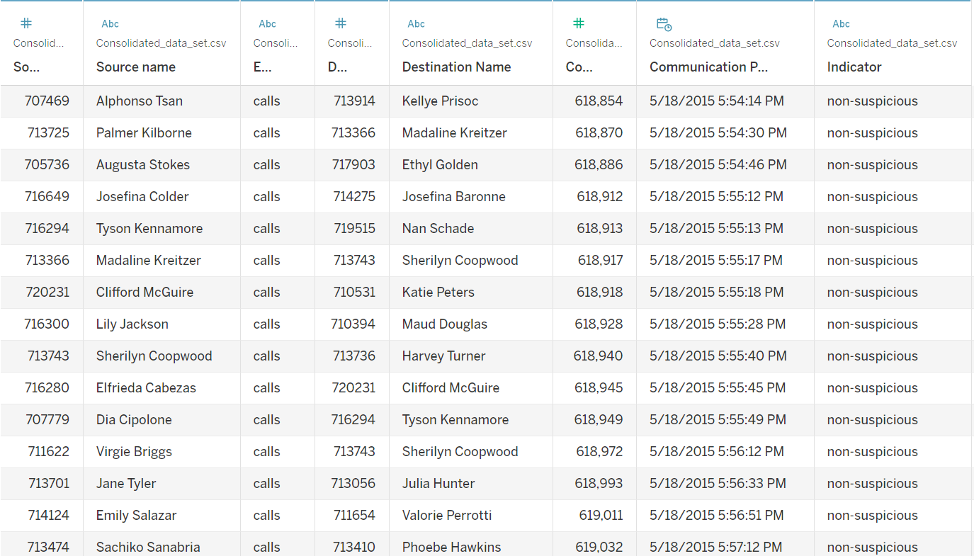
View of the Data after Pre-Processing

Slide 7
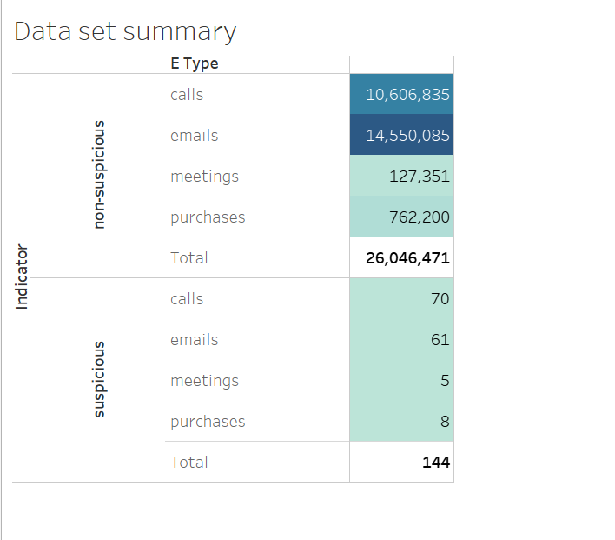
DATASET SUMMARY
From the data , we are able to observe that 144 suspicious communications happened over past 2 and half years and around 26 million non-suspicious communications.

Slide 8
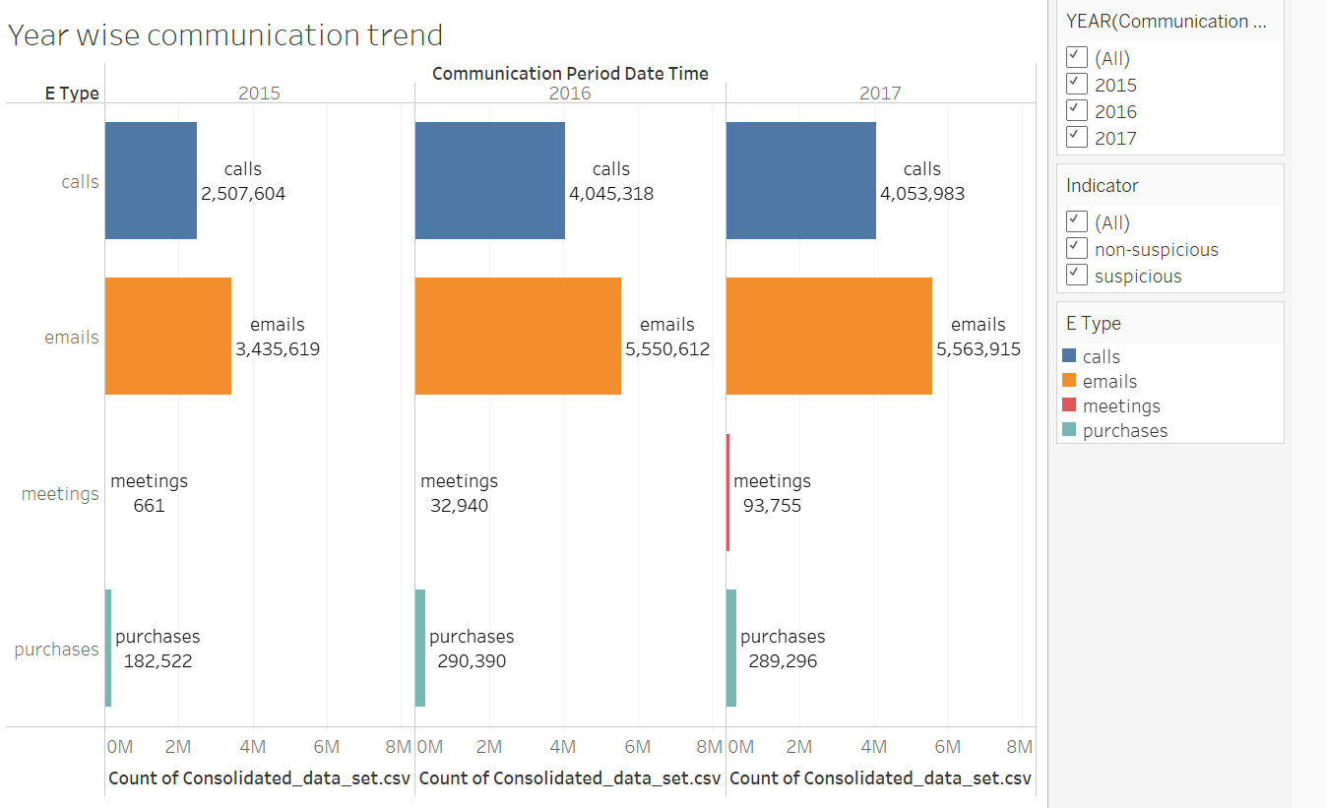
Year Wise communication Trend
From the graph, we are able to understand that every communication is increasing every year. Especially calls and emails happened every year more than meetings and purchases.

Slide 9
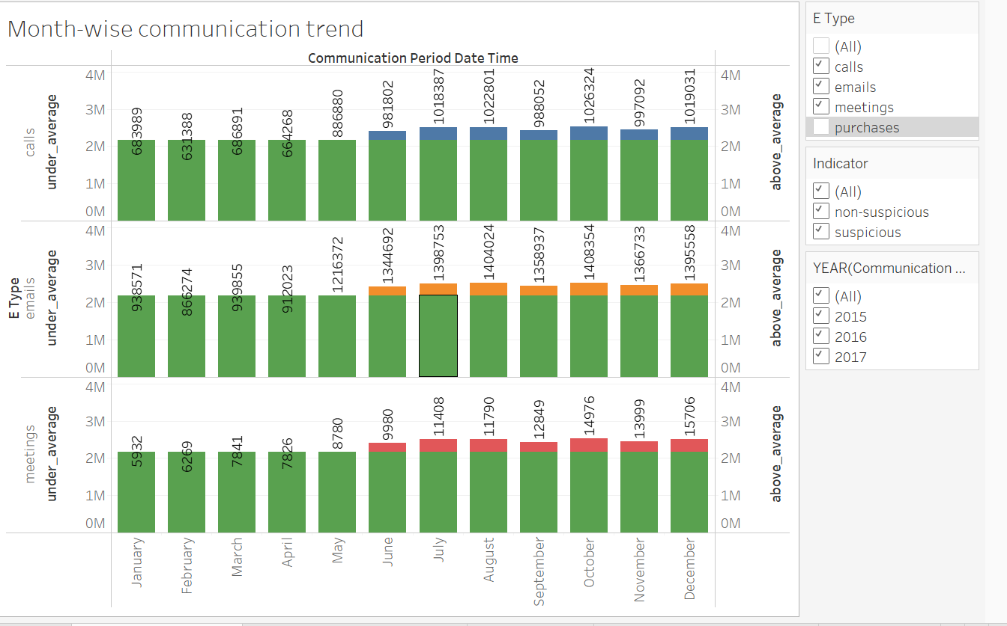
Month-wise Communication
Here we are able to understand more number of communications happened from June-December.
Green Color indicates all the communications happened below average and different color indicates the months in which more number of communications happened above Average.

Slide 10
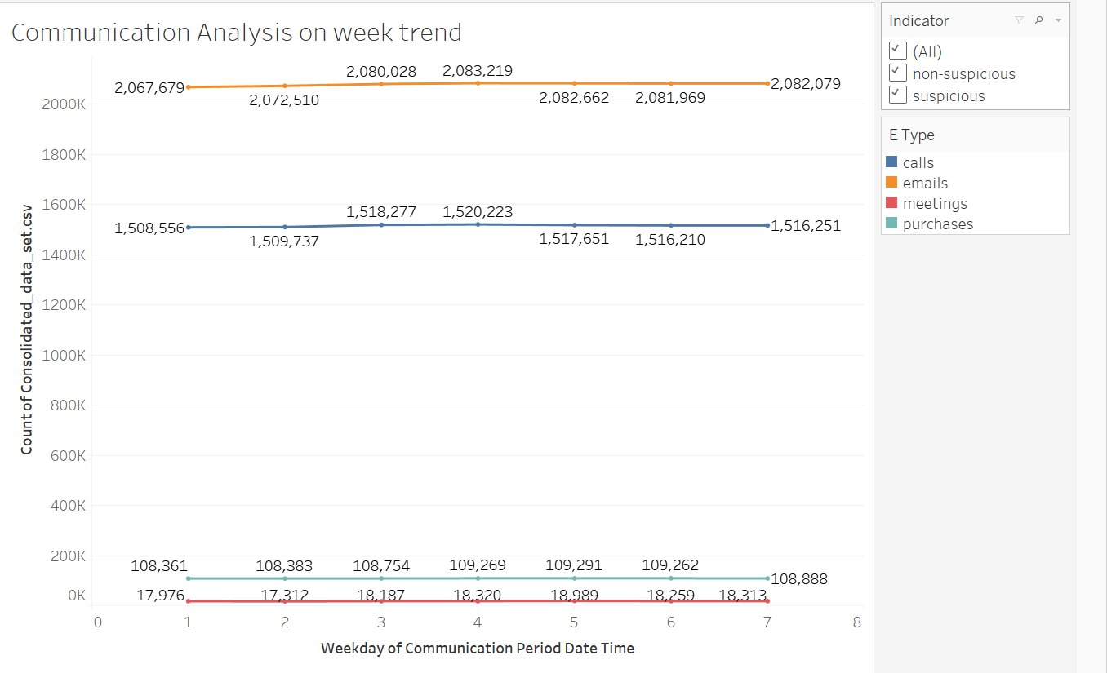
Communication Analysis on week trend
We want to observe on which day more number of communications happened over the years and we observed almost on every day same number of communications happened.

Slide 11
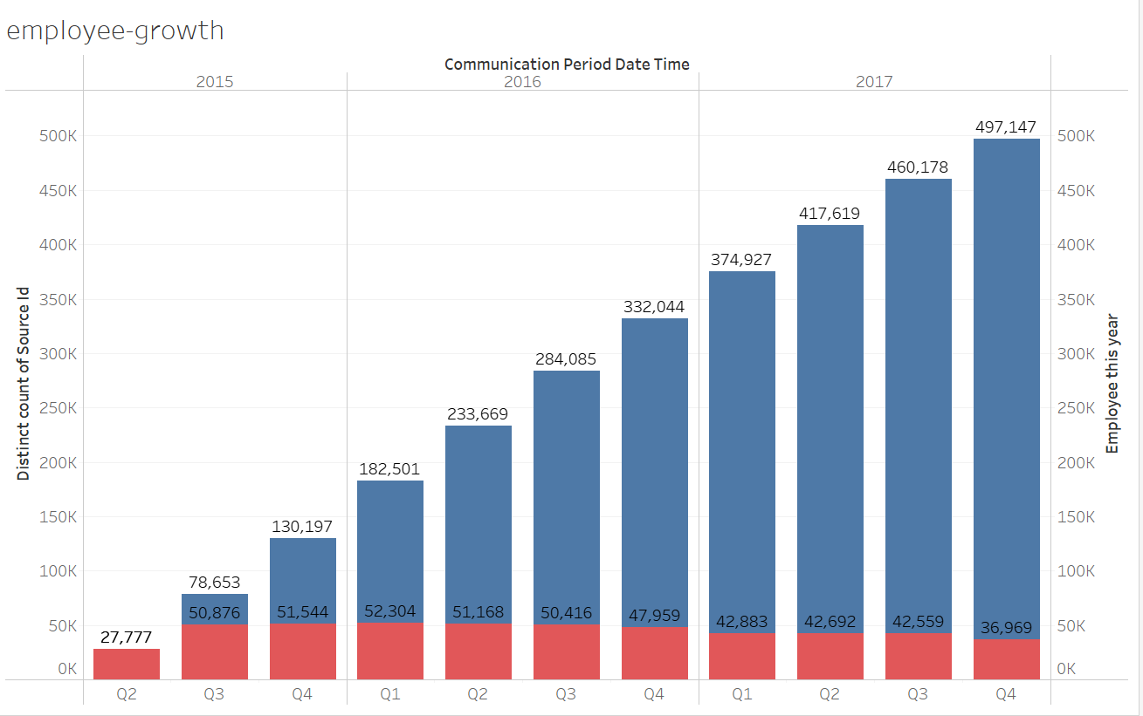
Employee Growth
By this graph, we are able to understand employee count over the year is increasing and we can observe that till Q3 of 2106 recruitment is almost constant from Q3 2015 to Q3 2016 and from next quarter recruitment of new employees has been decreased.

Slide 12
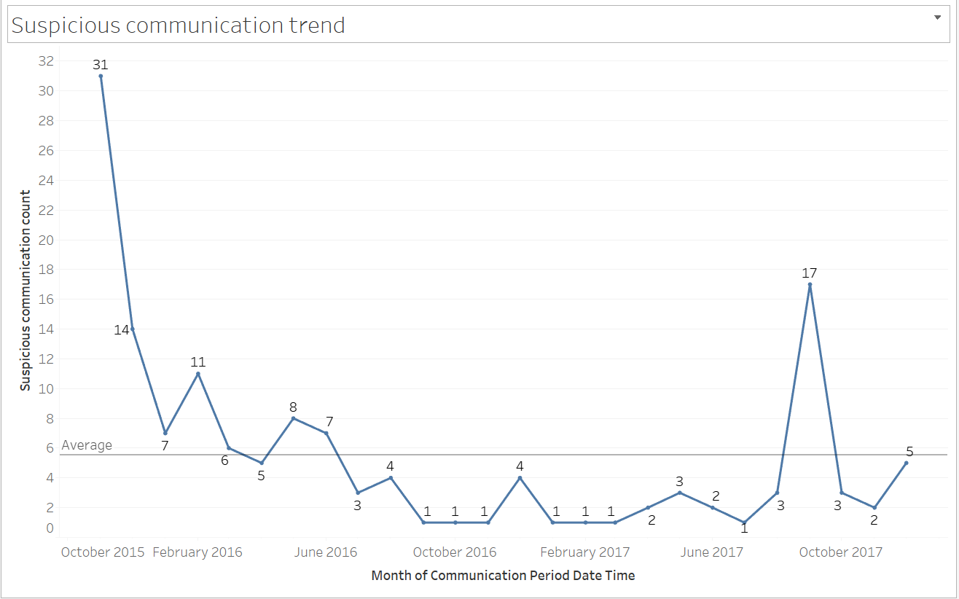
Suspicious communication trend
From the Graph, we can observe that 31 suspicious communications happened in Nov 2015 and In this graph, we can identify in which months suspicious communications happened below average and above average.

Slide 13
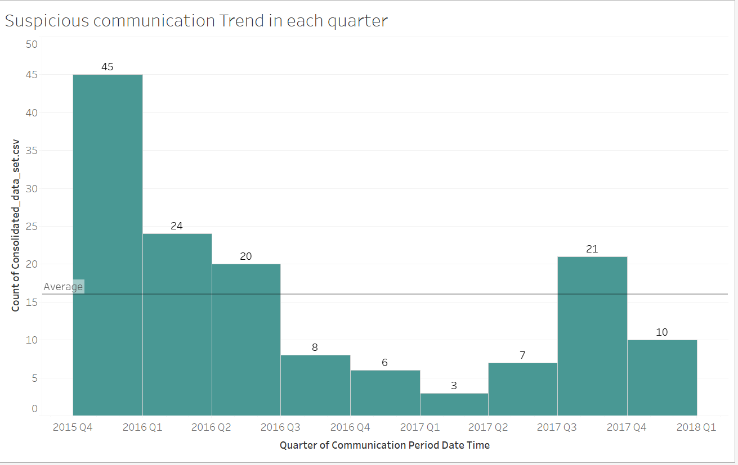
Suspicious communication Trend in each quarter
45 Suspicious communications happened in 2015 Q4 which ranks as the highest quarter in the given data. This graph clearly tells us which quarter has less suspicious communication than average and more than average.

Slide 14
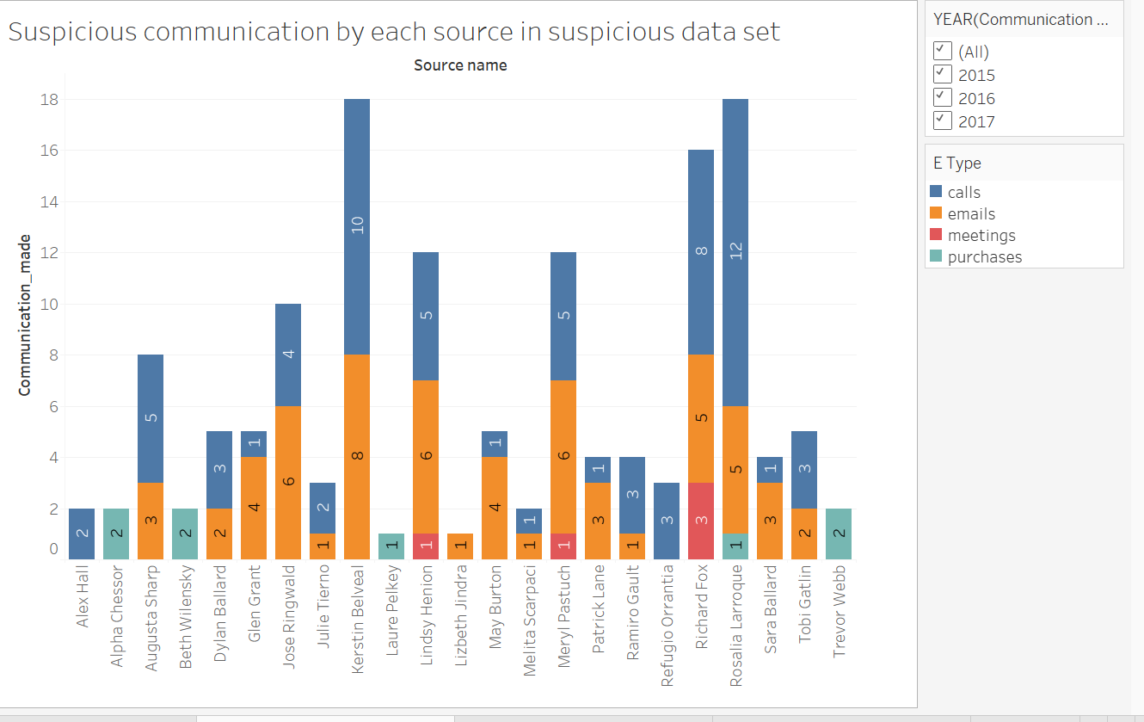
Suspicious communication by each source in suspicious data set
How many number of communications made by each source in the suspicious data set.
More number of Suspicious communications are done by Kerstin, Richard and Rosalia.

Slide 15
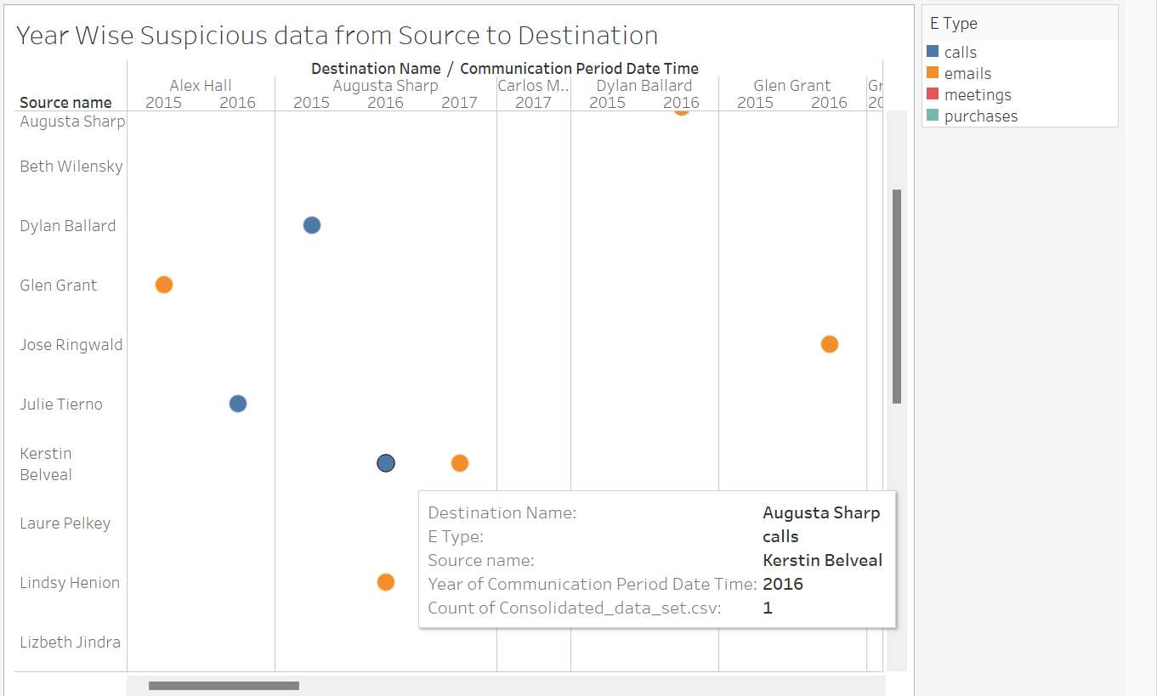
Year Wise Suspicious data from Source to Destination
This graph clearly states that how many number of communications happened in different years between each source to destination in Suspicious dataset.
For Example -1 suspicious call happened between Kerstin and Augusta in 2016.

Slide 16
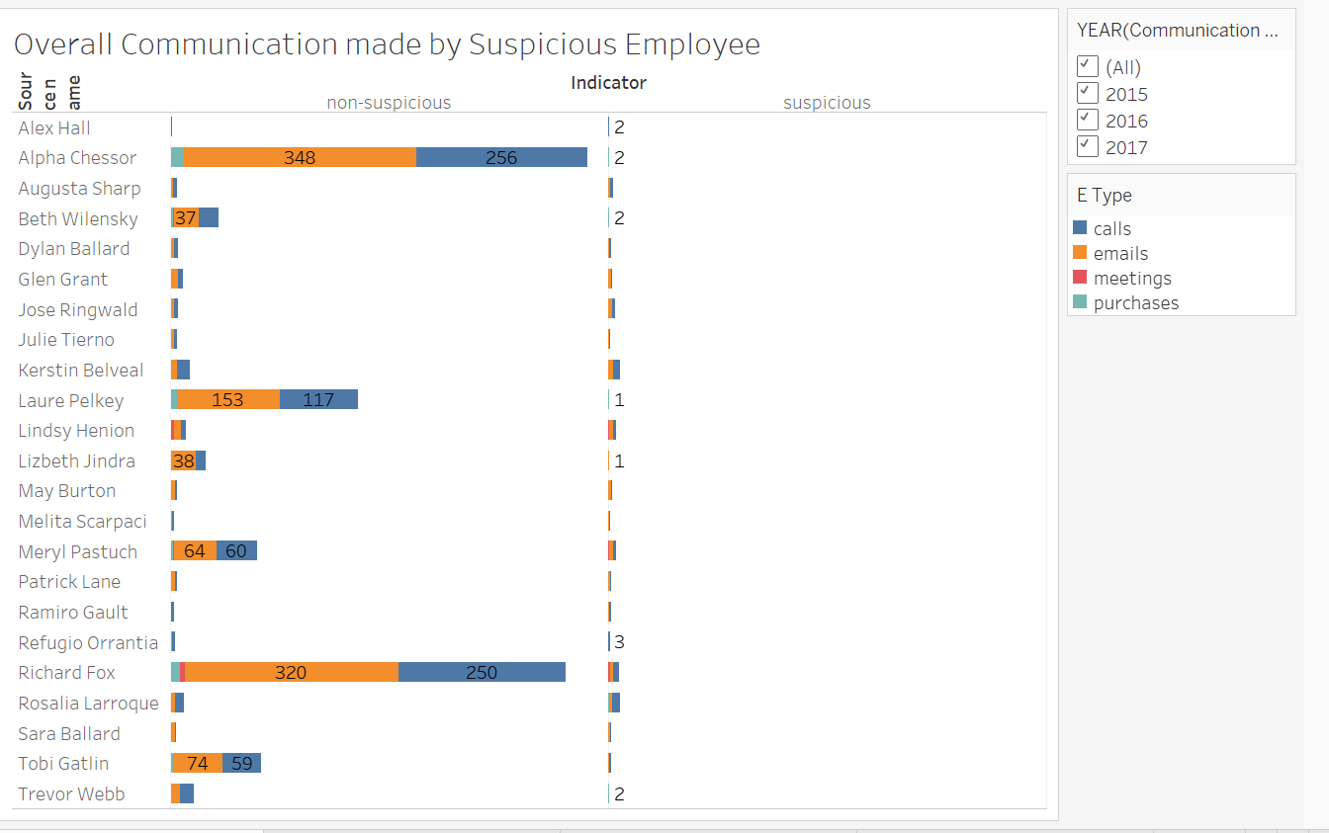
Overall Communication made by Suspicious Employee
This chart explains how much amount of communication made by each employee in suspicious dataset and how many are considered as suspicious and how many are considered as non-suspicious.

Slide 17
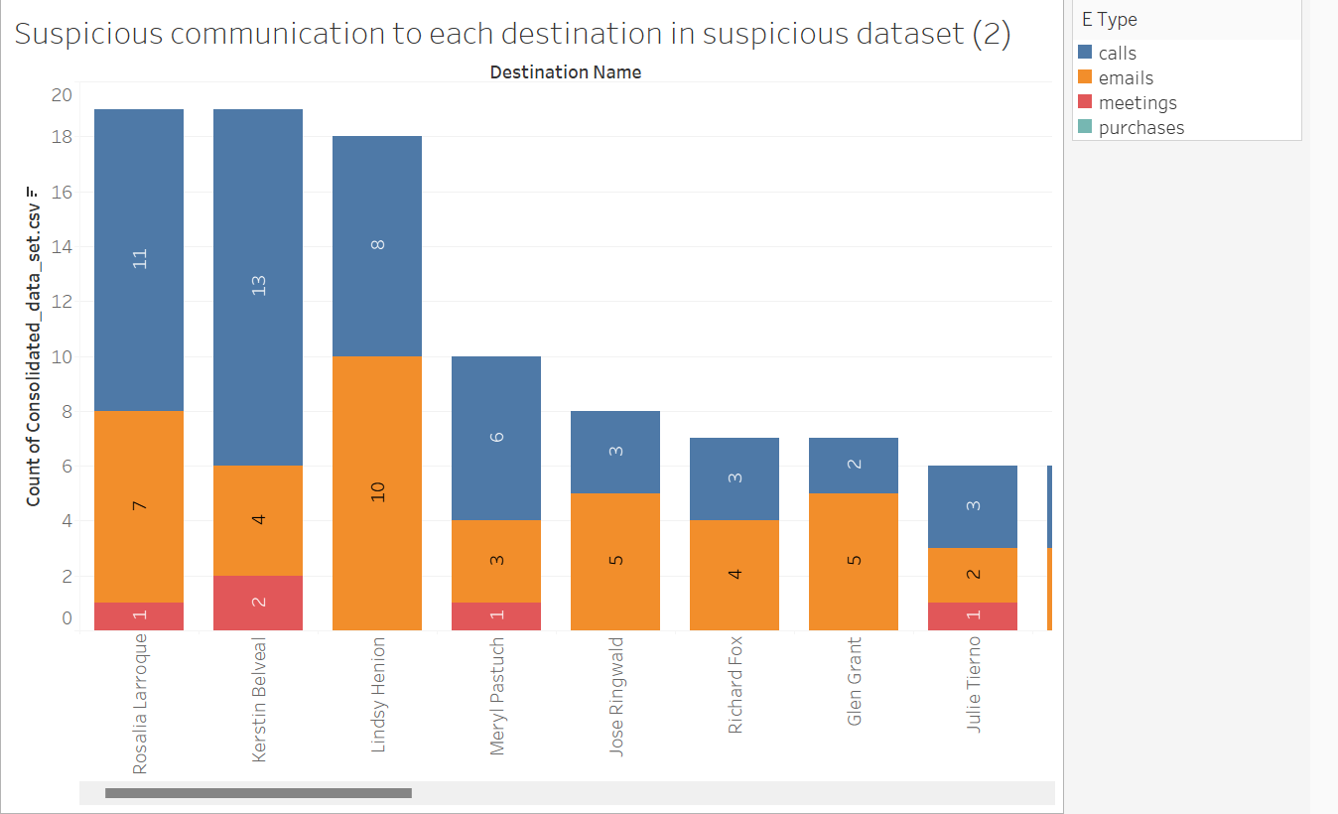
Suspicious communication to each destination in suspicious dataset
From the graph, we can observe that Rosalia is the destination who received more number of suspicious communications among others.

Slide 18
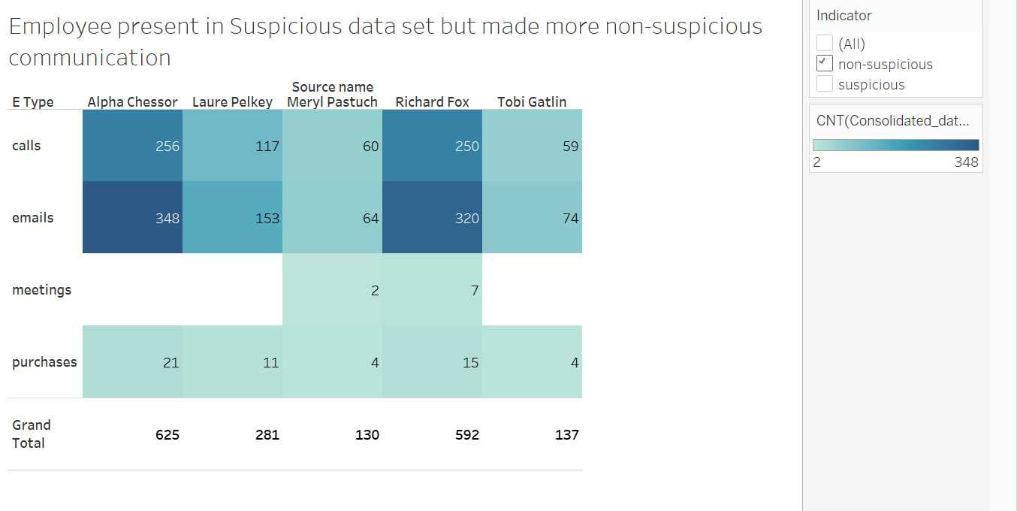
Employee present in Suspicious data set but made more non-suspicious communication
These are the 5 top people in suspicious dataset who made more non –suspicious communication.
Alpha ranks the highest among them.

Slide 19
THANK YOU

